Slide 1

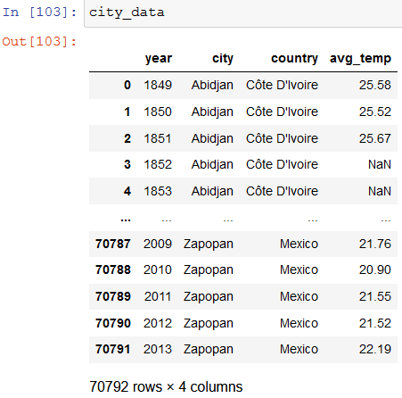
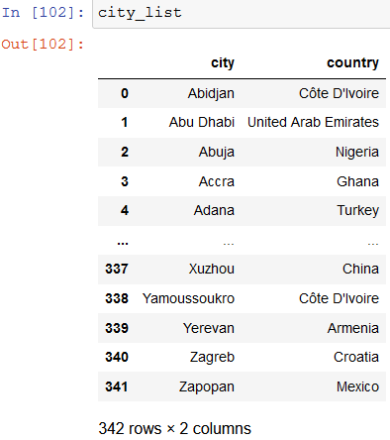
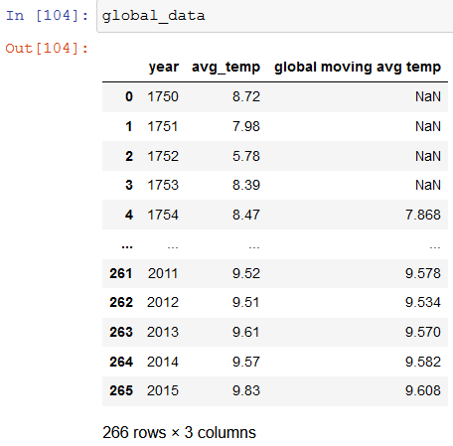
Data Extraction and Exploration
- 3 Queries were used on the Udacity website to extract the data in .csv format:
- select * from city_data;
- select * from city_list;
- select * from global_data;
Then I used python jupyter notebook to read and explore the resulting .csv

Slide 2
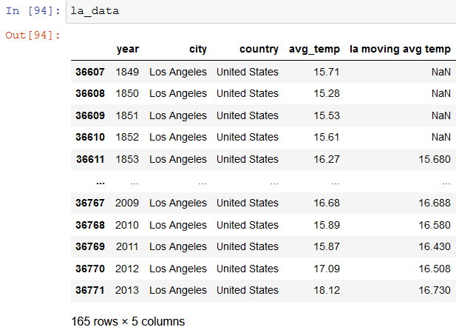
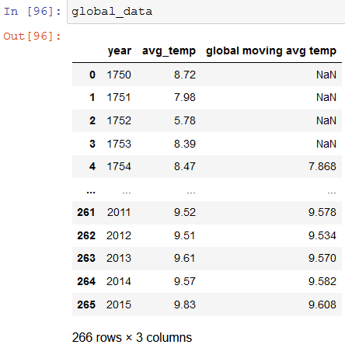
Data Creation
Created moving average temperatures for Los Angeles and Global
la_data['la moving avg temp'] = la_data.iloc[:,3].rolling(window=5).mean()
global_data['global moving avg temp'] = global_data.iloc[:,1].rolling(window=5).mean()
The moving average was calculated using pandas .rolling() method, where the “windows=“ is used to select how many rows of the average temperature column column I would like to select, then use the mean() method to get the averages among those rows of year
Results:

Slide 3
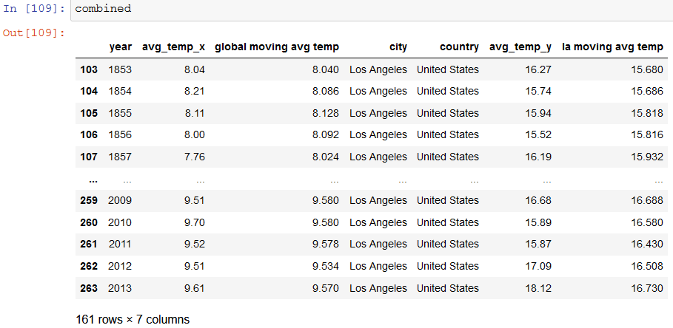
Data Merging and Cleaning
I used the .merge() method and performed a left join with the global_data and la_data tables, with the moving averages added
I noticed that Los Angeles only has average temperature data from 1853 to 2013, so I selected only the rows with that range of years
-combined = global_data.merge(la_data, left_on='year', right_on='year', how='left')[103:-2], results:

Slide 4
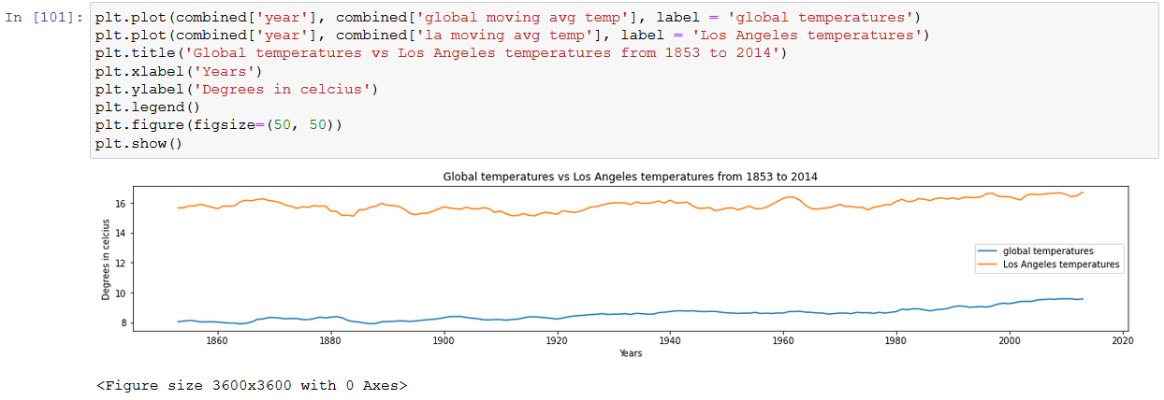
Data Visualization
I used matplotlib.pyplot library visualize the Los Angeles’ and Global’s moving average temperature changes from 1853 to 2013,
A line chart was chosen because it is the most appropriate for telling changes in values over time

Slide 5






Findings
Los Angeles, from the years 1853 to 2013, is about 7.32 degrees Celsius hotter than the global average
Los Angeles has a range in average temperature fluctuations of about 1.6 degrees Celsius, while the world has 1.69 degrees Celsius
Los Angeles’s hottest year on record was in 2013, while the coldest year was in 1880, the world’s hottest year on record was in 2015, while the coldest year was in 1752.
The temperatures all around the world have been steadily increasing, I believe that the hottest year on record would be 2020 if there was data available in this dataset.

